Slide 1

FDA
Analytics
Platform
Presented by the Trends · Insights · Growth · Evaluation · Risk · Simulation​ -Team

Slide 2
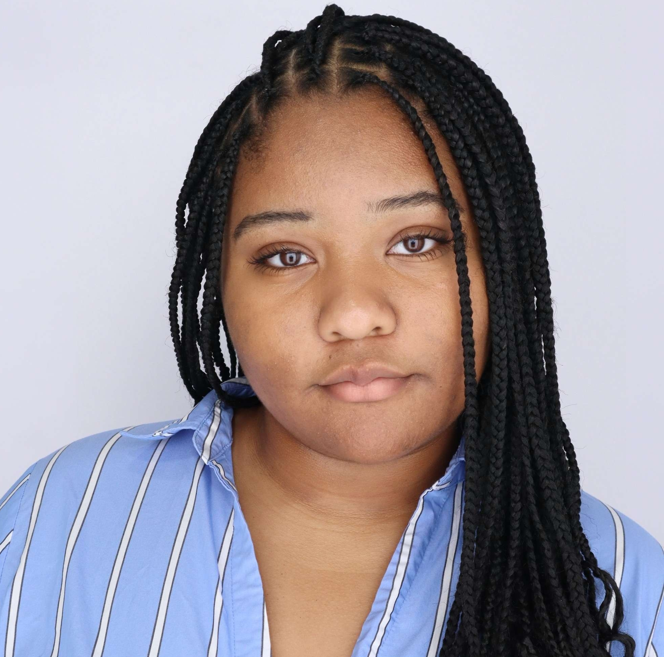


Meet The T.I.G.E.R.S
Breana
Ramesh
Lordina
Data Preparation &
Design
SAS Viya Predictive Modeling (ML & Forecasting)
Python ML &
Prescriptive Insights
Notes:
Team introductions. Breana: data prep. Ramesh: SAS forecasting. Lordina: Python ML and design.

Slide 3
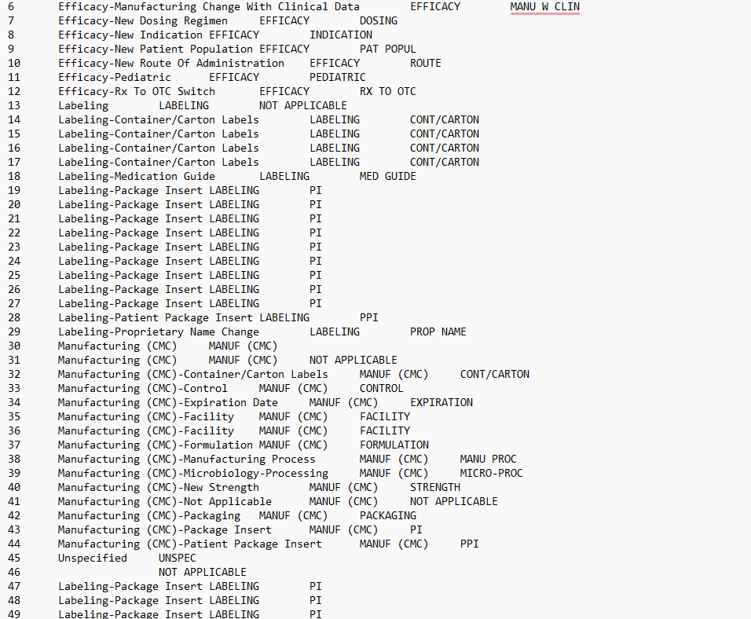
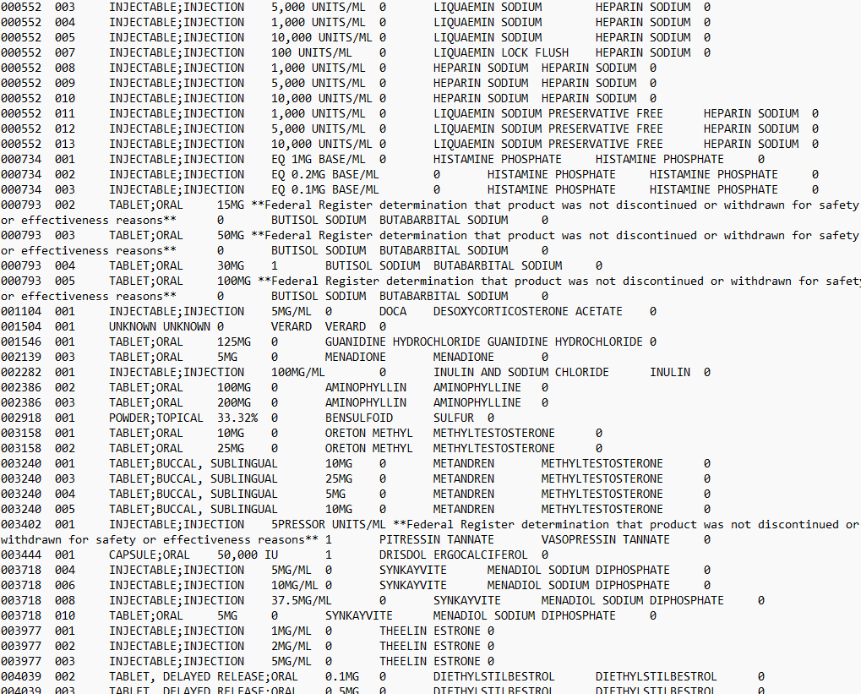
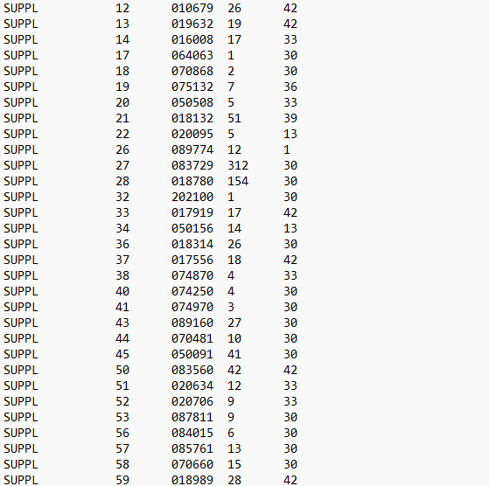
How many drugs are submitted to the FDA per year for approval?
Notes:
What use see above isn’t just raw data its 190k lines of data spread across 12 unorganized tables pkatform selling ont data TIME IS MONEY

Slide 4
Problem Statement
Pharmaceutical stakeholders face significant challenges in transforming Data.gov's vast, unstructured FDA datasets into clear, actionable insights —leaving critical gaps in drug approval analysis, outcome prediction, and market opportunity identification.​
Notes:
Time is MOney

Slide 5
Purpose Statement
Convert raw FDA datasets from Data.gov into clear, decision-ready intelligence by delivering descriptive, predictive, and prescriptive insights through a unified Power BI, SAS Viya, and Python analytics platform—bridging the gap between data and strategy.
Notes:
Time is MOney

Slide 6

Notes:
Intercative Dashboard – sell it to CGI not present the Dashboard (why to buy)?
We have created this model
Less techinacal more business focusewd

Slide 7
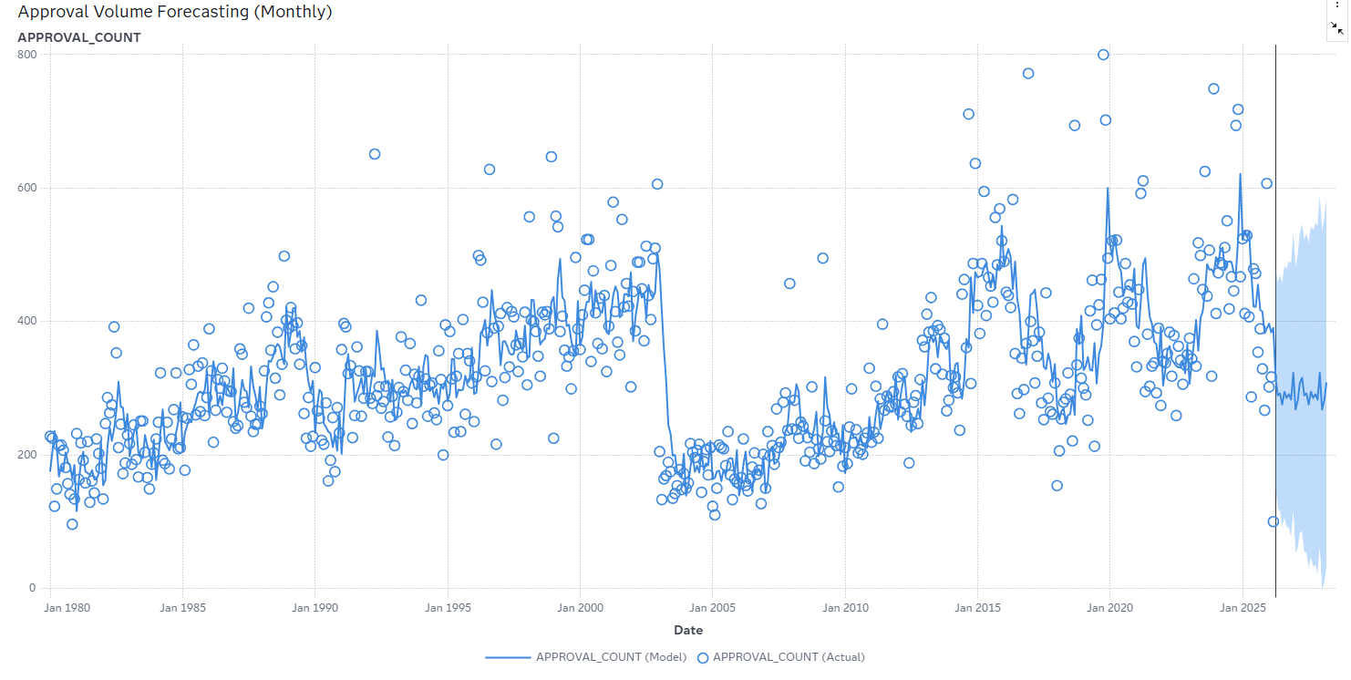
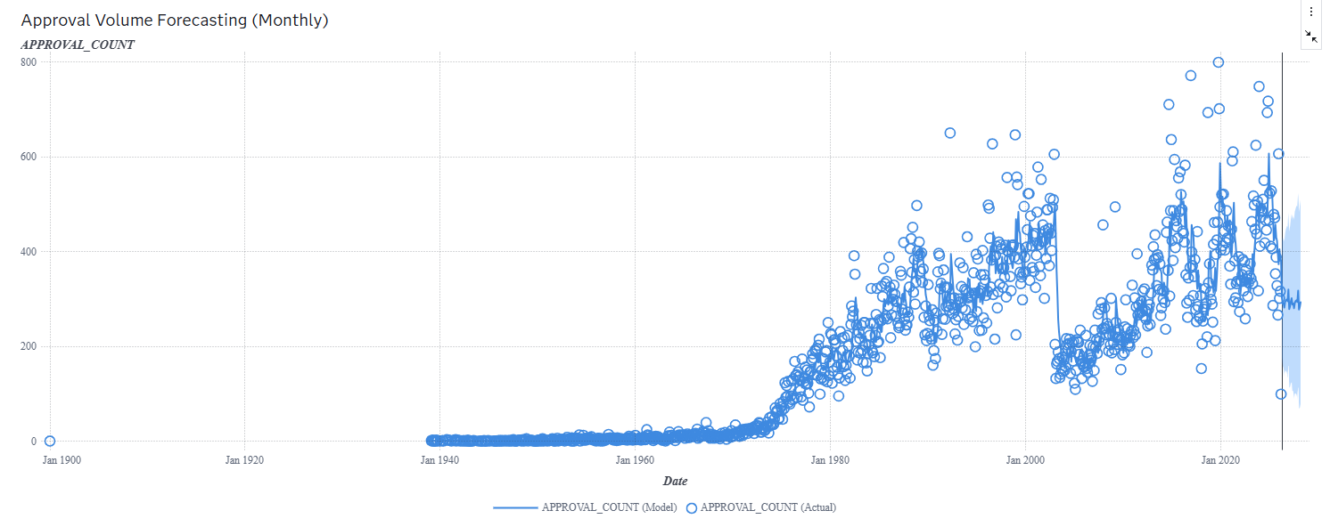
Approval Volume Forecasting (Monthly)
Table: Submissions (Date, Approvals)
Model
ARIMA
24-month forecast horizon
After: Seasonal Exponential Smoothing
Predicted (Mar 2028): ~294 approvals
After: ~308 approvals
95% CI: 79 – 509
After: 31– 585
(From 1980)
Notes:
Updated automatically

Slide 8
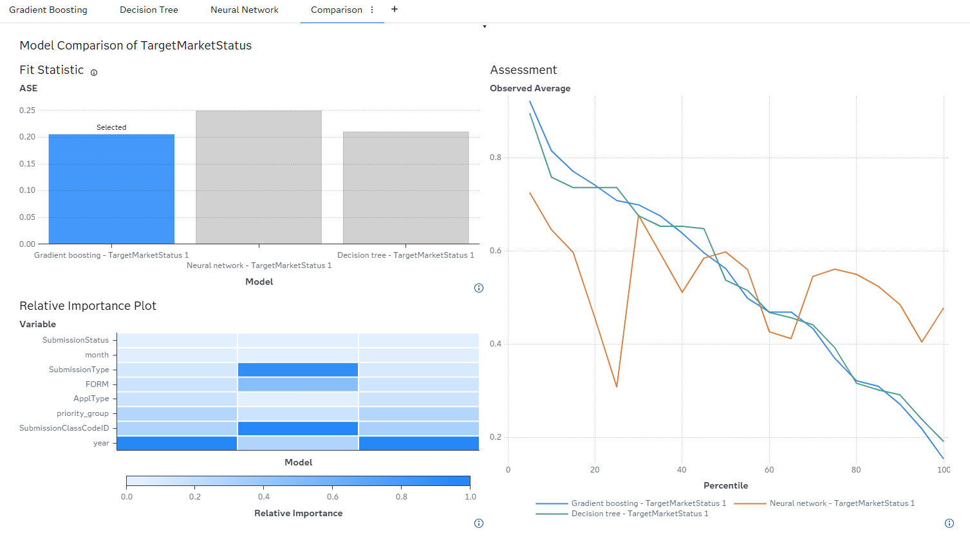
Market Continuity Prediction for Approved Drugs
Objective​:Predict whether an approved drug will remain Active or become Discontinued post-approval.​
Tables:
Applications
Submissions
Products
Marketing Status
Target Variable(Market Status)
1 → Active (Prescription, OTC)
0 → Discontinued / For Further Manufacturing Use
Best Model
Gradient Boosting
Lowest ASE – 0.2051
Best predictive performance

Slide 9
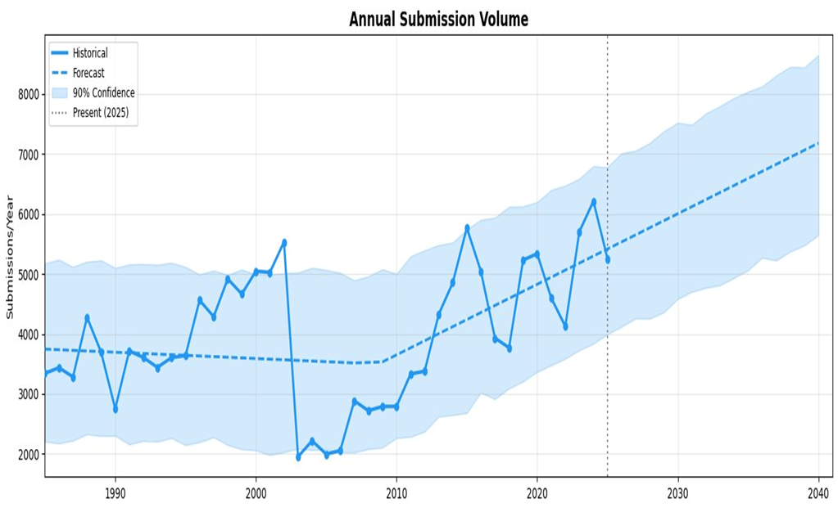
Python Forecasted Results to 2040
Objective: Forecast future FDA submission volumes using historical trends (1985–2025), projecting through 2040.
Random Forest – Key Features
Auto-downloads 12 FDA tables
7 features
200 trees, balanced classes, 5-fold stratified CV
~0.85 ROC-AUC
Forecast Summary
Model: Prophet time-series forecasting
Train Period: 1985 –2025
Est. 2040: ~7,100 /year
Trend: Growing
Notes:
Buget cotrnaist from sas say this
What is facebook prophet
Just say it dowloads from the current fda table we have diccussed befire
Trained 5 times x2
Facebook phrophet gain
The trained period we used for this model was from 9185 into 2025 and then we predicted it to 2040
To mnay statitcs on the slided but more words like the defintiuon of facebook prophet
Don’t rmable on the prescriptive impact try to onl say the bold words
Don’t repeat and slwo dwon
Tomany words on prescrptive impact
Lost me at theend
Prescrptie impact

Slide 10
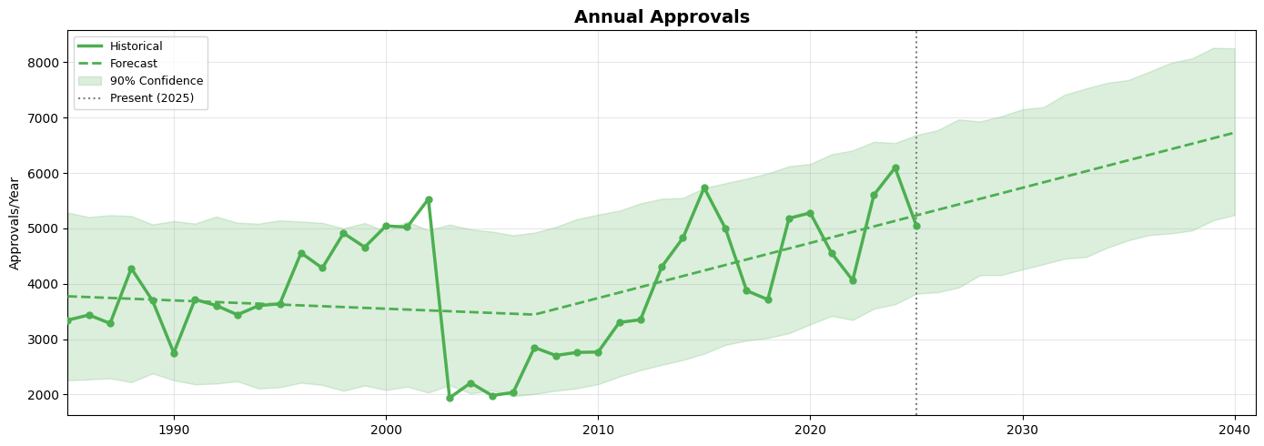
Python Forecasted Results to 2040
Model: Prophet time-series forecasting
Train Period: 1985 –2025
Est. 2040: ~6,600 /year​
Trend: Growing​

Slide 11
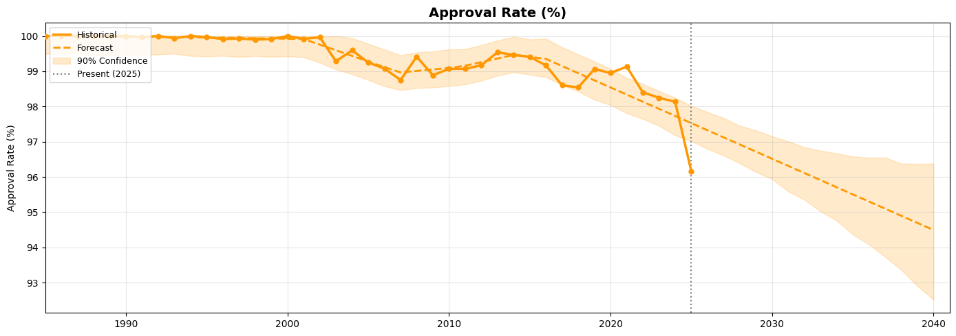
Python Forecasted Results to 2040
Model: Prophet time-series forecasting
Train Period: 1985 –2025
2025 Rate ~96.1%​
Est. 2040: ~94.4%​

Slide 12
Prescriptive Impact
✓
Time & Cost Savings
Processes 100,000+ records in under 3 minutes , saving 200+ analyst hour
✓
Scalable & Repeatable Architecture
Auto-downloads, retrains, and rescores with zero manual intervention
✓
Universal Framework
Our pipeline is not FDA-specific — the same architecture (ingestion, feature engineering, classification, forecasting, risk scoring) can be applied to any structured dataset
✓
Future-Proof Data Integrity
As data volumes explode across industries, our built-in validation and cleaning ensures every decision is based on trustworthy data , not noise.
Notes:
Intercative dashboard how to move forward
Time in Money on a bullet point

Slide 13

Conclusion
+
Q&A

